Slide 1

Flight Delay Prediction using Graph Invariants
M.Tech Thesis Presentation
at
IIT Kharagpur
West Bengal-721302
Mohammed Kashif
21MA60R39
M.Tech
Department of Mathematics
Computer Science and Data processing
April 24, 2023

Slide 2
Table of contents
Introduction & Motivation (1 min)​
Purpose of work (1 min)
Data Description (1 min)
Previous work - Methodology (2 min)
Univariate and Multivariate Time Series Analysis (1 min)​
Hybrid Model (2 min)
Result and Discussions (1 min)
Conclusions (1 min)
2

Slide 3
Introduction & Motivation
The Flight delay is inevitable and it plays an important role in both profits and losses of the airlines.
An accurate estimation of flight delay is critical for airlines
Providing prior knowledge of flight delays on a particular day
To make business intelligent decisions by the service provider.
To compare the performances of the individual airline industry.

Slide 4
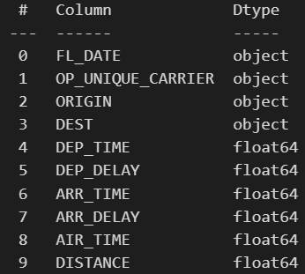
Description of data set
USA’s flight data with 360 airports (year-2019)
There are 19 parameters available in data set
There are strong correlation between departure delay and arrival delay.
Airline Delay and Cancellation Data, 2009 - 2018 | Kaggle

Slide 5
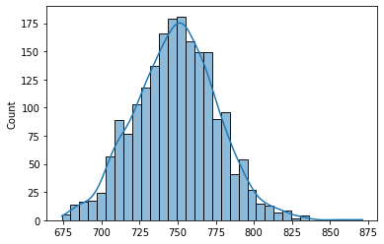
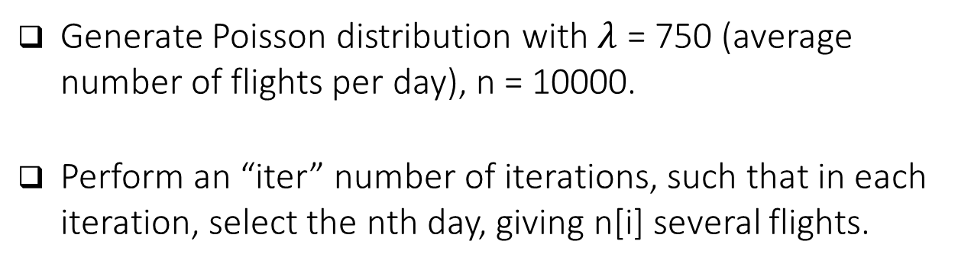
Previous Work - Stochastic Modelling and analysis
Generate Poisson distribution with $λ$ = 750 (average number of flights per day), n = 10000.
Perform an “iter” number of iterations, such that in each iteration, select the nth day, giving n[i] several flights.
Randomly select n[i] a number of flights (data points) from the original data.
Compute independent variables

Slide 6
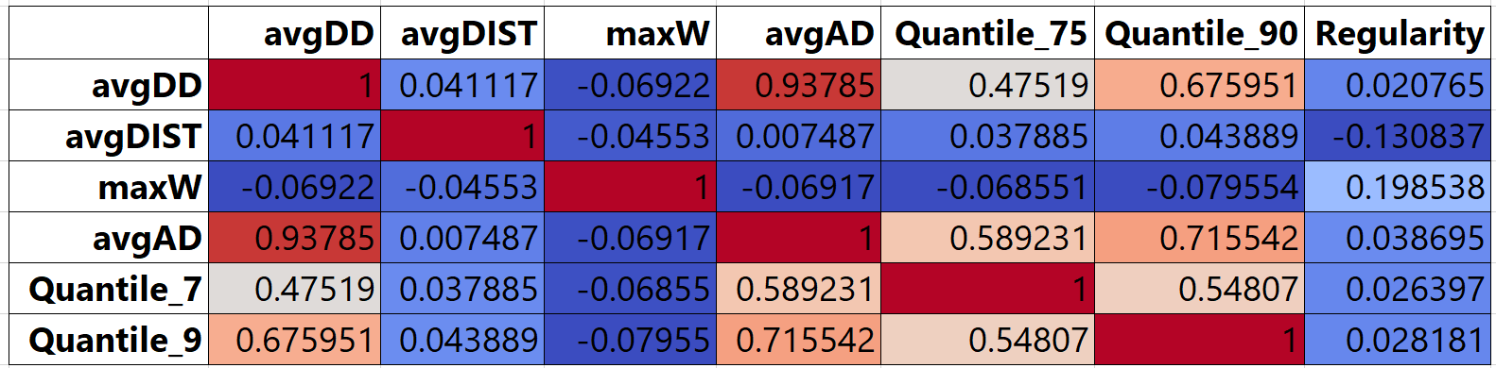
Previous work – Correlation matrix:
6

Slide 7
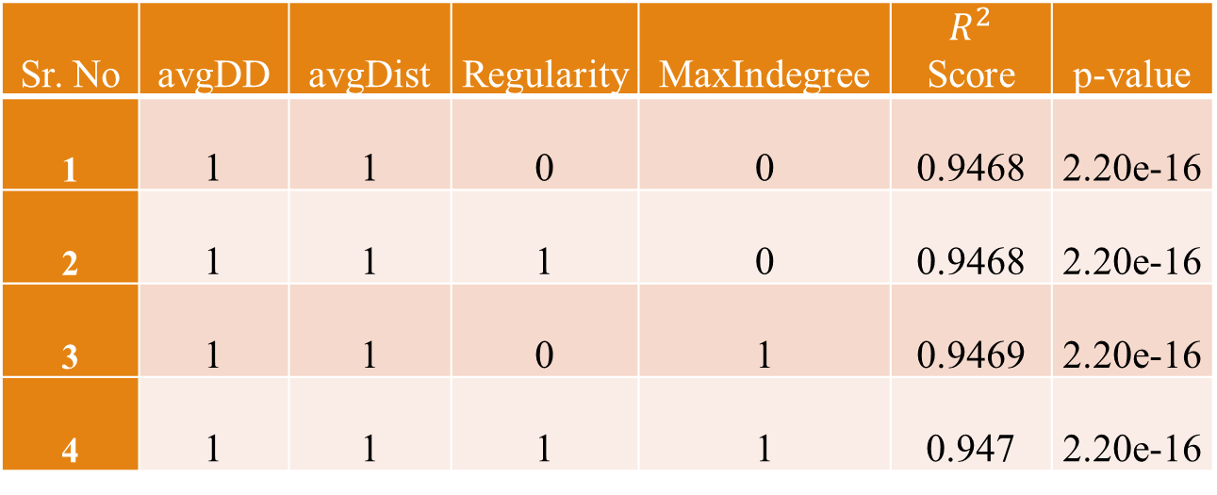
Previous work – R2 score as performance measure:
Sr. No | avgDD | avgDist | Regularity | MaxIndegree | $R^{2}$ Score | p-value
1 | 1 | 1 | 0 | 0 | 0.9468 | 2.20e-16
2 | 1 | 1 | 1 | 0 | 0.9468 | 2.20e-16
3 | 1 | 1 | 0 | 1 | 0.9469 | 2.20e-16
4 | 1 | 1 | 1 | 1 | 0.947 | 2.20e-16

Slide 8
Previous work – Partial correlation coefficient:
Sr. No | Variable | Partial corr coeff | p-value
1 | avgDD | -0.330754115 | 9.46e-254
2 | avgDIST | 0.065209092 | 6.78e-11
3 | Regularity | 0.004533591 | 6.504109e-01
4 | MaxIndegree | -0.025339279 | 1.129671e-02

Slide 9
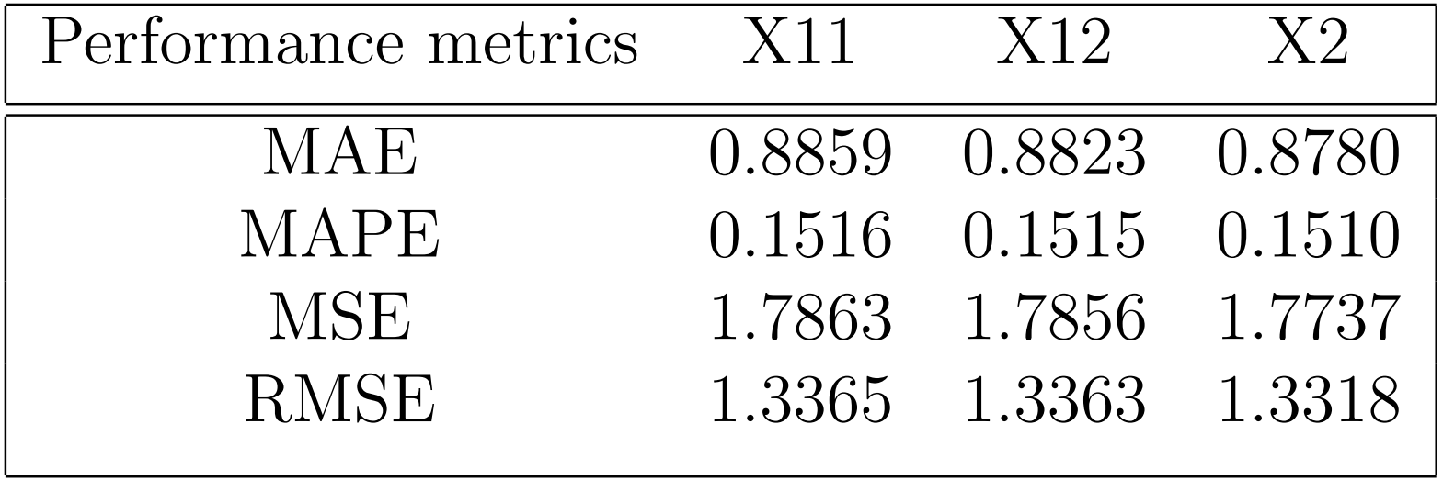
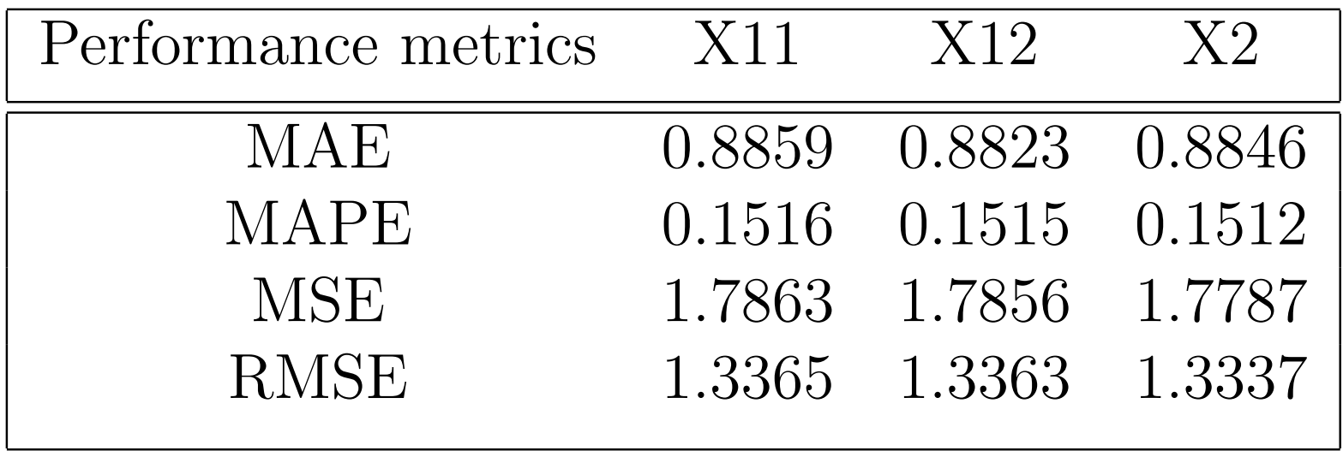
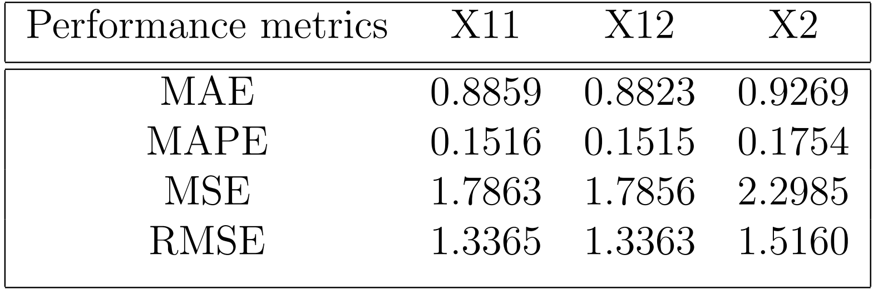
Regularization:
Without Regularization
Ridge Regularization
Lasso Regularization

Slide 10
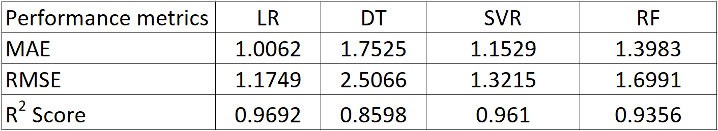
Model selection:

Slide 11
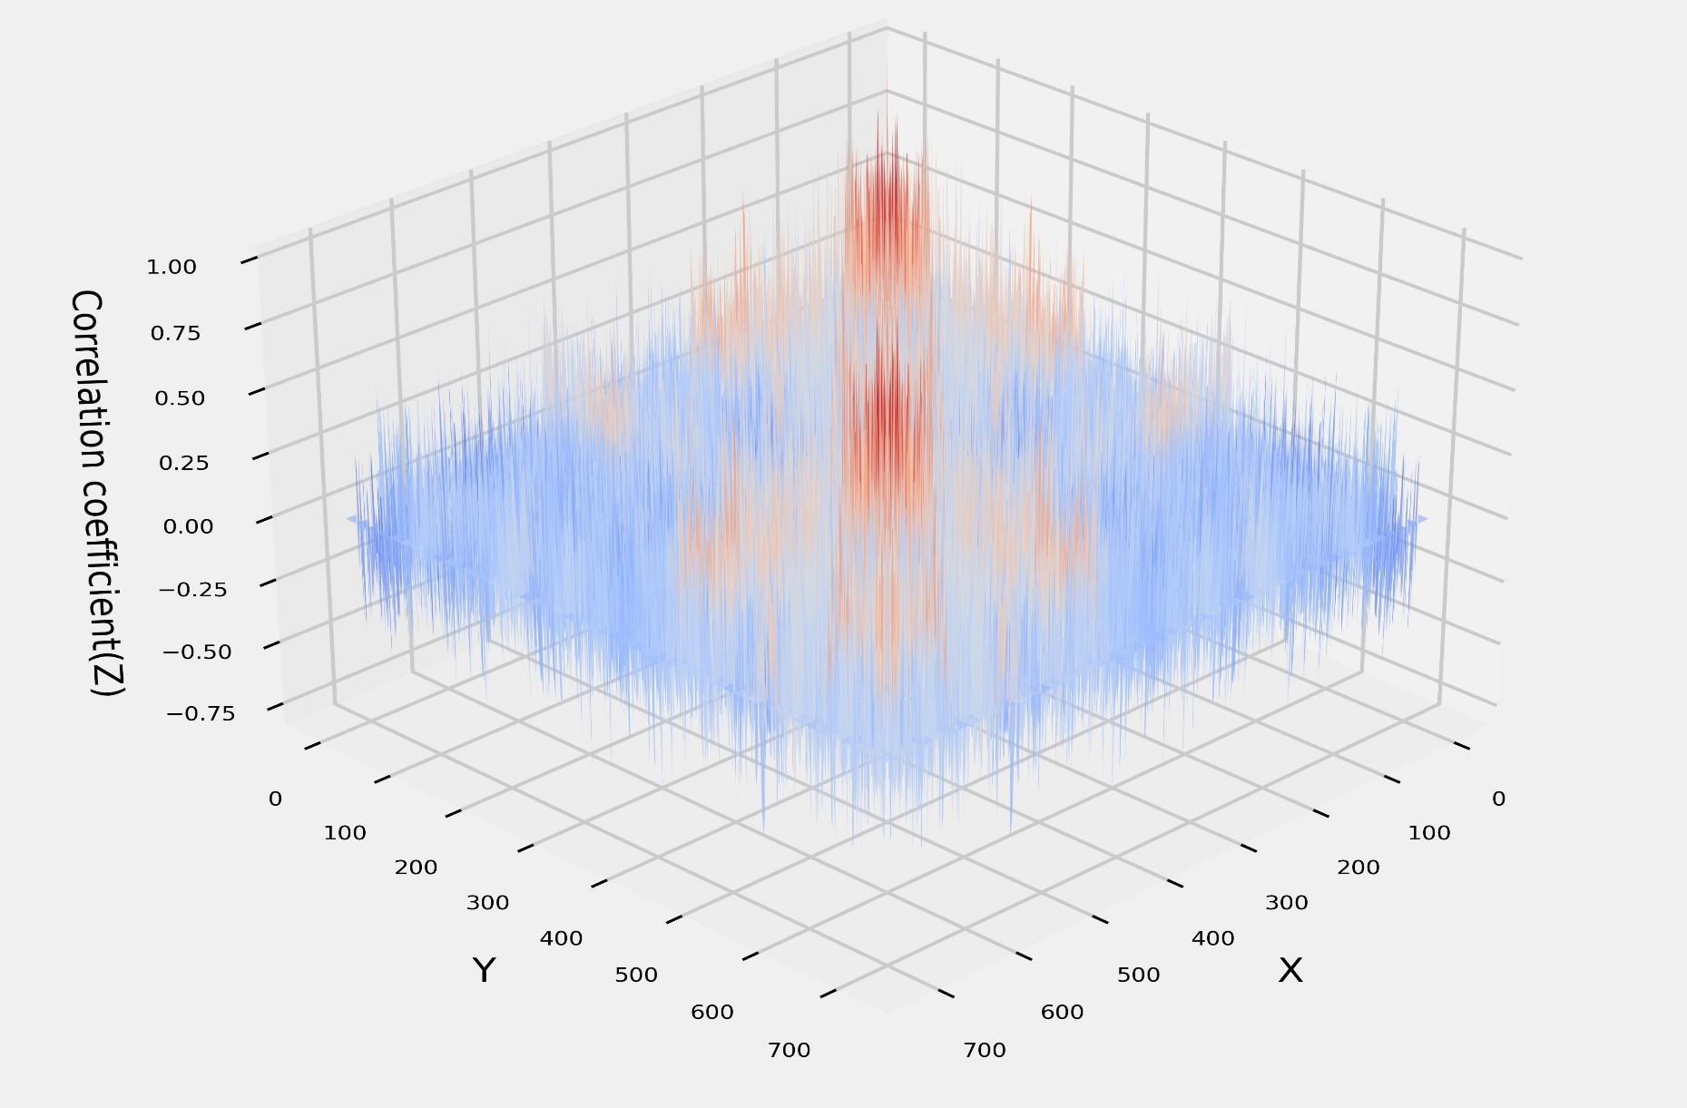
Average departure delay vs
Graph Invariants

Slide 12
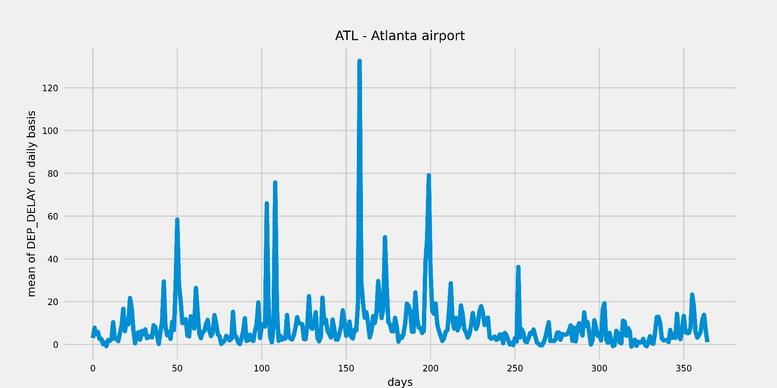
Univariate Time Series Model

Slide 13
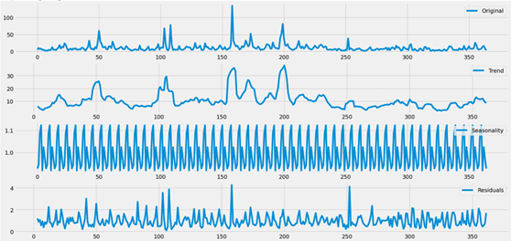
Univariate Time Series Model

Slide 14
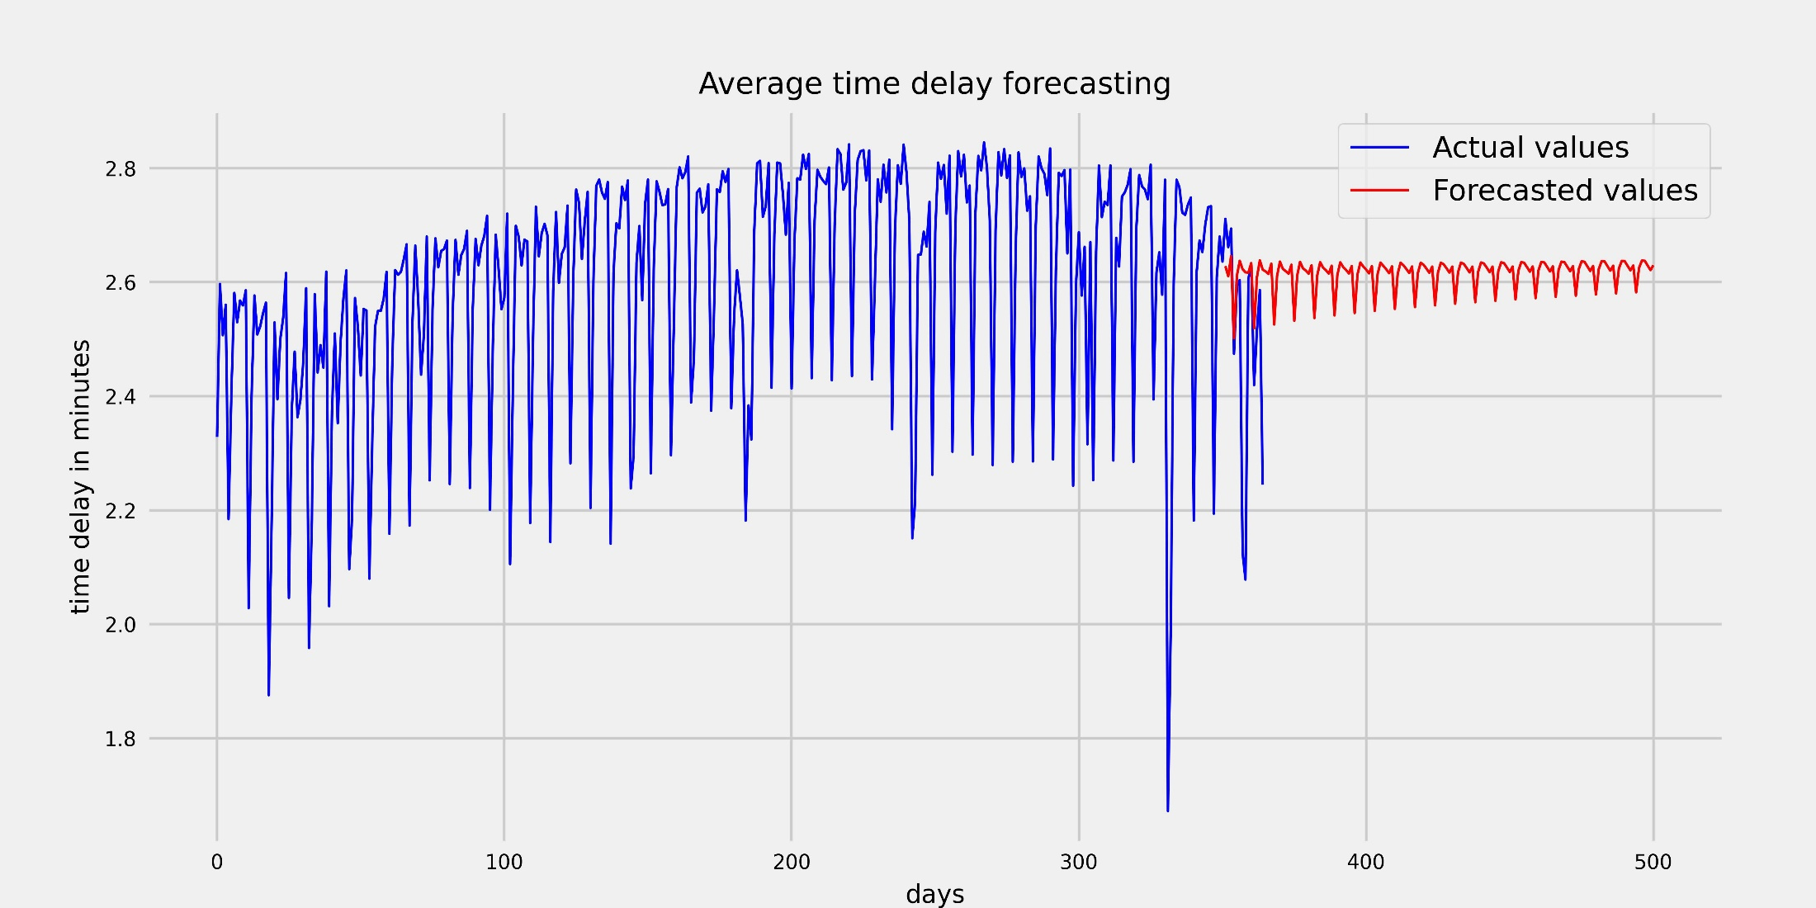
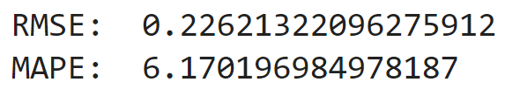
Multivariate Time Series Analysis

Slide 15
Hybrid Model
01
02
Multivariate time series model
Regression model
past values of “avgDD”
Forecasted values of “avgDD”
Future values of “avgAD”
Level-01
RMSE = 0.2318
Level-02
RMSE = 5.3813
Future values = 15
RMSE = 5.7146

Slide 16
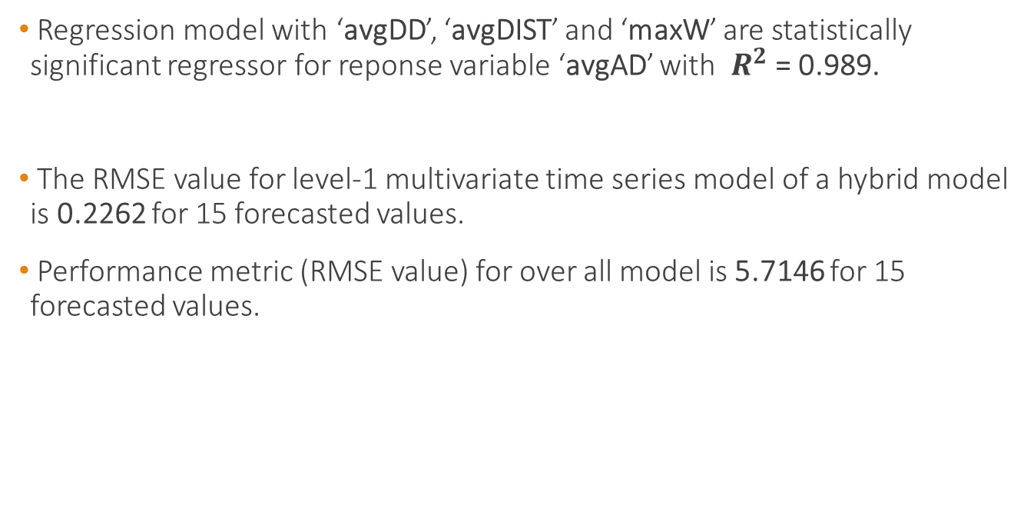
Results and Discussions
Regression model with ‘avgDD’, ‘avgDIST’ and ‘maxW’ are statistically significant regressor for reponse variable ‘avgAD’ with $R^{2}$ = 0.989.
The RMSE value for level-1 multivariate time series model of a hybrid model is 0.2262 for 15 forecasted values.
Performance metric (RMSE value) for over all model is 5.7146 for 15 forecasted values.

Slide 17
Conclusions:
Average departure delay, Max-Indegree and average distance are statistically significant with average arrival delay.
Regularity has the least correlation with average arrival delay. It is computationally expensive and has been tested to be statistically least significant.
This Hybrid model is new approach which uses time series and regression model to give forecasted values of flight delay.

Slide 18
Reference
[1] Peter J Brockwell and Richard A Davis. Introduction to time series and forecasting. Springer, 2002. [2] Warittorn Cheevachaipimol, Bhudharhita Teinwan, and Parames Chutima. Flight delay prediction using a hybrid deep learning method. Engineering Journal, 25(8):99–112, 2021. [3] R Mary Jeya Jothi and Ebin Ephrem Elavathingaln. Analyzing the regularity of complete k-partite graph using super strongly perfect graphs. In 2015 Online International Conference on Green Engineering and Technologies (IC-GET), pages 1–5. IEEE, 2015. [4] Douglas C Montgomery, Elizabeth A Peck, and G Geoffrey Vining. Introduction to linear regression analysis. John Wiley & Sons, 2021.

Slide 19
Reference
[5] Jeremy Watt, Reza Borhani, and Aggelos K Katsaggelos. Machine learning refined: Foundations, algorithms, and applications. Cambridge University Press, 2020.
[6] William WS Wei. Multivariate time series analysis and applications. John Wiley & Sons, 2018.
[7] Maryam Farshchian Yazdi, Seyed Reza Kamel, Seyyed Javad Mahdavi Chabok, and Maryam Kheirabadi. Flight delay prediction based on deep learning and levenberg-marquart algorithm. Journal of Big Data, 7:1–28, 2020.

Slide 20
Thank You

Slide 21

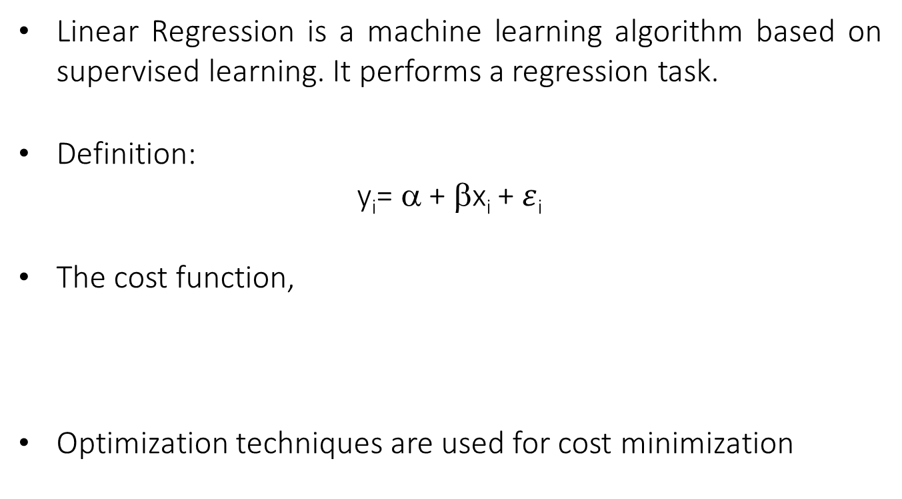
Polynomial Regression Regression
Linear Regression is a machine learning algorithm based on supervised learning. It performs a regression task.
Definition:
y_{i}= α + βx_{i} + $ε$_{i}
The cost function,
Optimization techniques are used for cost minimization

